Slide 1
Smart-Event
2019
Powered by
Enterprise Mobile Engineering

Slide 2



SD Leadership – 4th to 6th June
Utsav 2019 – 12th to 14th June
DS 2019 – 16th to 18th June

Slide 3
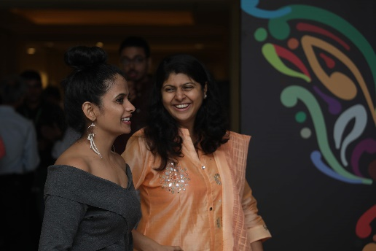
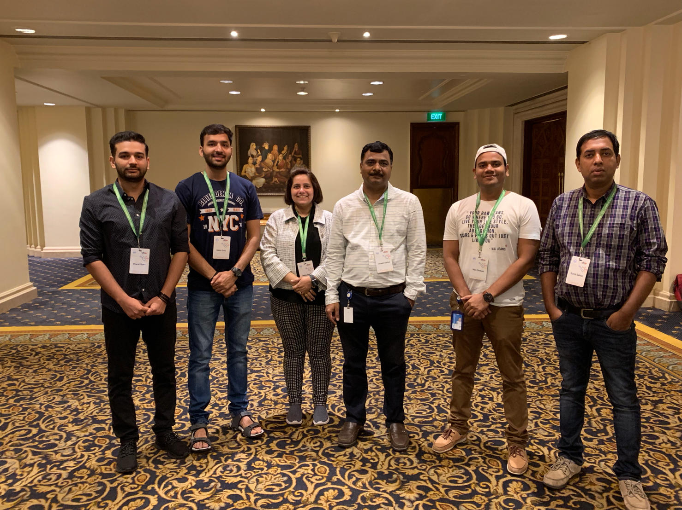
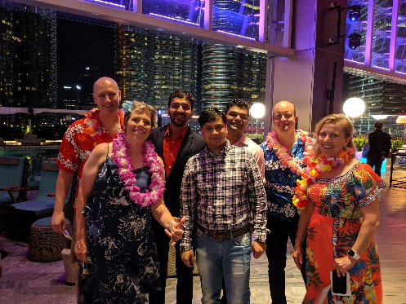
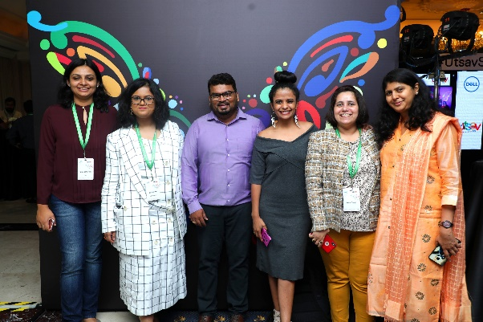

Slide 4
Success Story

Slide 5



How are your KPIs performing ?
 | Google Play Store | App Store
Average Rating | 5.00 | 5.00
Average User | 12 | 16
SD Leadership
Austin Event
How are your KPIs performing ?
 | Google Play Store | App Store
Average Rating | 5.00 | 5.00
Average User | 90 | 43
DS 2019
Malaysia Event
How are your KPIs performing ?
 | Google Play Store | App Store
Average Rating | 5.00 | 5.00
Average User | 291 | 101
Utsav 2019
Bangalore Event

Slide 6
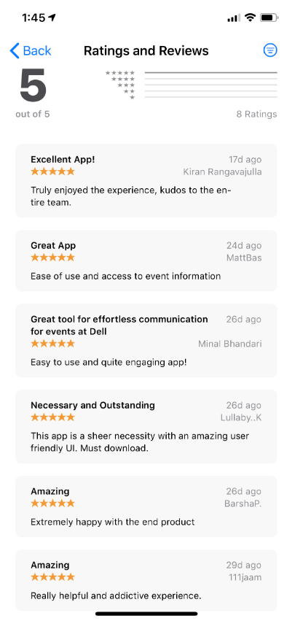
Utsav 2019
I want to extend my heartfelt appreciation and gratitude to the mobility team for building the event app for both the India and Malaysia Summit. The app helped us automate various processes viz., attendance tracking, swag inventory mgmt, agenda, survey, live posting and the ingenious QR and FR based registration! The team was prudent and enterprising to explore these new requirements from us and was very thorough in testing that we experienced 0 hiccups on the day of the event.
From technical prowess to winning together is was an absolute pleasure working with the team! They stand united, always available and went the extra mile to ensure we passed the governance requirements, I am amazed by the sheer positive energy and the “get it done” attitude of the team
Special mention to
Umesh for prioritizing the summit app over other projects. I know this was free work yet he put the best talent and hours into making this a success. We are ever so grateful.
Neha – you are delight to work with. You tick all the right boxes of a stellar PM – you wear empathy as your armor 😊
Nikhil – you are genius! You made this happen, thanks for toiling all those long hours coding and being available even before us at the venue for support.
We hope to extend this app to the US and Ireland summits and will also be the brand ambassador at the T&P council and will spread the msg to other Bus
----- Anushka Bose

Slide 7
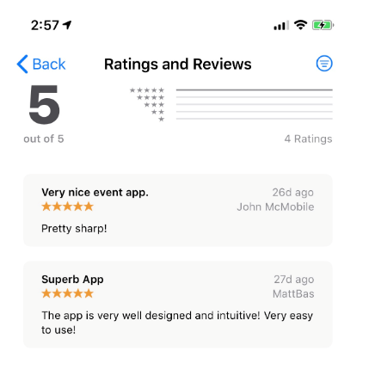
DS 2019
SD Leadership
The app was fabulous (both India and Malaysia) – really appreciate your support – looking forward to bringing the team into the Talent and program council so we can spread across Dell!
--- Jennifer Erickson

Slide 8
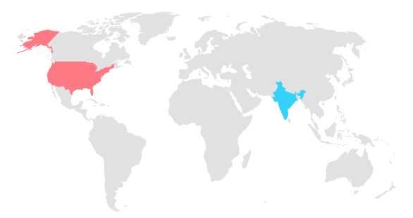
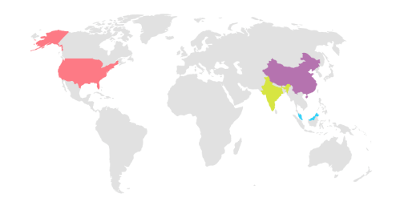
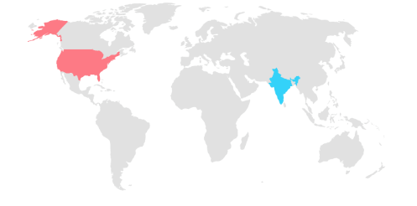
SD Leadership
DS 2019
Utsav 2019

Slide 9
Vision/Outcome of the Event App
Positive lift in Brand Perception
Event App created a foot print for the digital transformation journey
Deep Customer Insights – We got immediate feedback from our customers

